Slide 1
Block Chain Fundamentals and HyperLedger
Presented BY: Manjunath N V
yoda@security-exploits.com
LinkedIn: https://www.linkedin.com/in/manjunath-kumar-1a222a18

Slide 2
Who am I – Manjunath N V
Education
B.E. in Computer Science (Bangalore University)
Post Graduation in S.O.C (university of Edinburgh, Glasgow)
Post Graduation in Digital Network Communication(London Metropolitan university)
Professional Experience
15+ Years of Consulting and Training experience in Programming, Networking, testing & Security.
Hold 20+ Active Professional Certifications in SECURITY
Have Trained 3000+ People in Last 8 Years in IT Security
WARNING – MAD about Security (can talk Hours on the Subject)

Slide 3
Blockchain Introduction

Slide 4
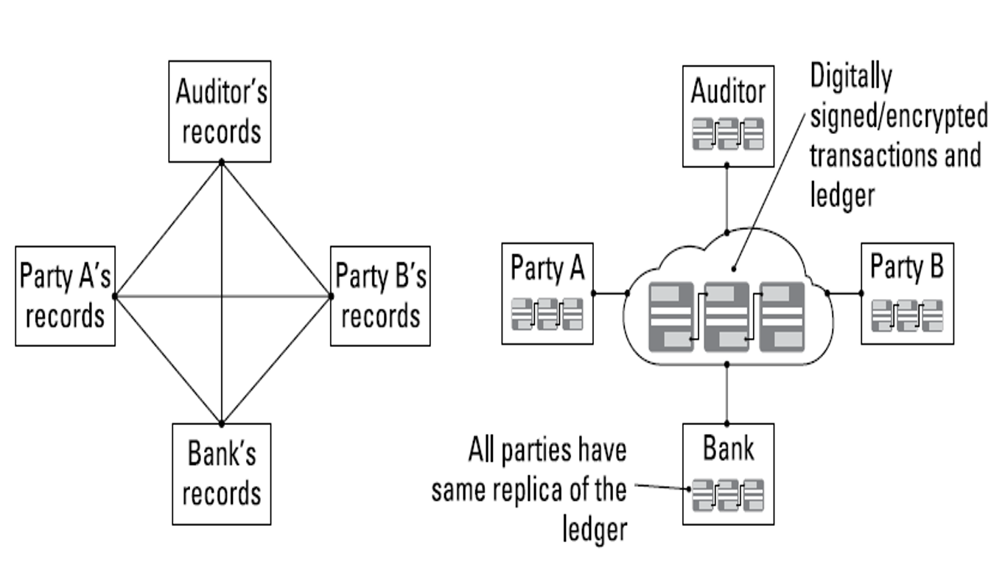
Tracing Blockchain’s Origin
The shortcomings of current transaction systems
During 2000’s financial crisis

Slide 5
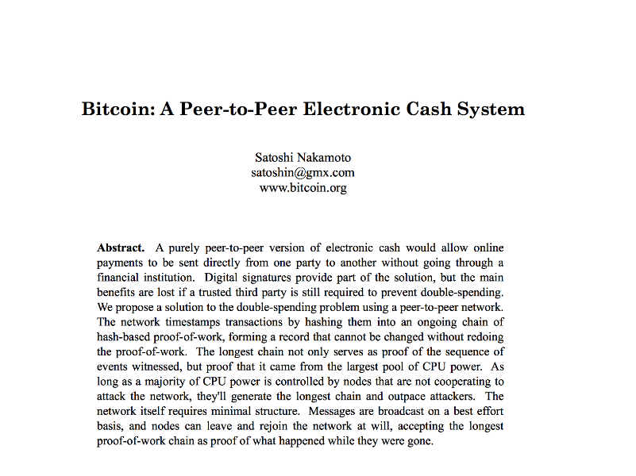
Bitcoin Whitepaper: 10/31/2008
https://bitcoin.org/bitcoin.pdf

Slide 6


Digital Currency
The most successful among lot of efforts: Bitcoin
Replace cash with numbers and codes
Advantages
Fast
International
Easy accounting
Weighs nothing
Cheap
Problems to be solved

Slide 7
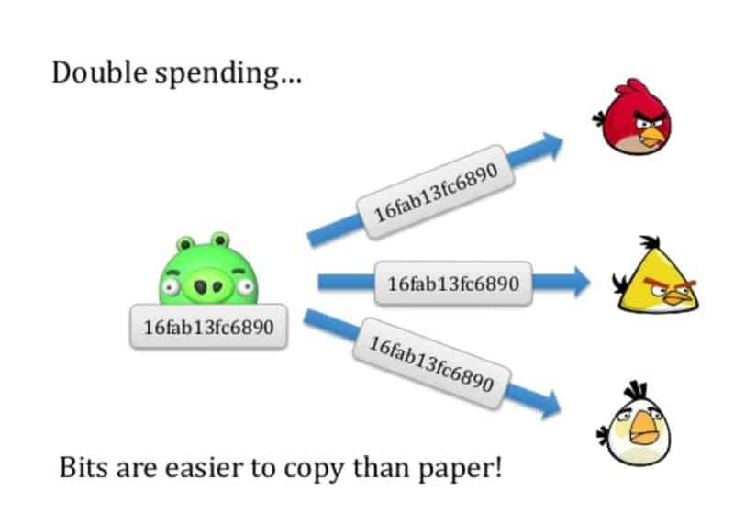
Problems of Digital Currency
Perfect Copy
Just like downloading attachment from email
How to distinguish counterfeits
Ownership Problem
Double Spending
Networks are noisy and transmission across networks is far from instantaneous: delay
A hacker can capitalize
Fraudster Detection Problem

Slide 8
The Long Road to Bitcoin
Centralized Banking: not robust
Satoshi determined to find the centralized part of banks
The ledger
“What if I could turn a bank inside out? Instead of one central party controlling the ledger, what if every user were recruited to maintain a constantly updated copy?”
The strength of the digital was perfect copies, so copy the ledger, everywhere, instantly.
Any ledgers with even one common not agreeing with the masses would be discarded, leaving fraudsters powerless
Replace cash with Ledger!

Slide 9
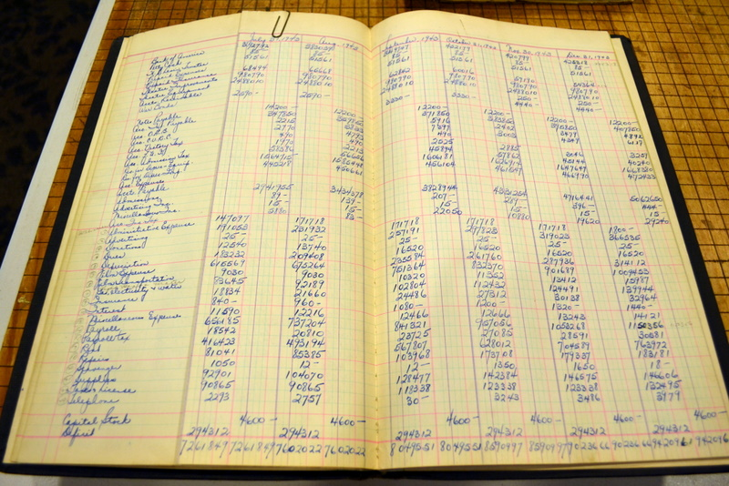
Ledger

Slide 10
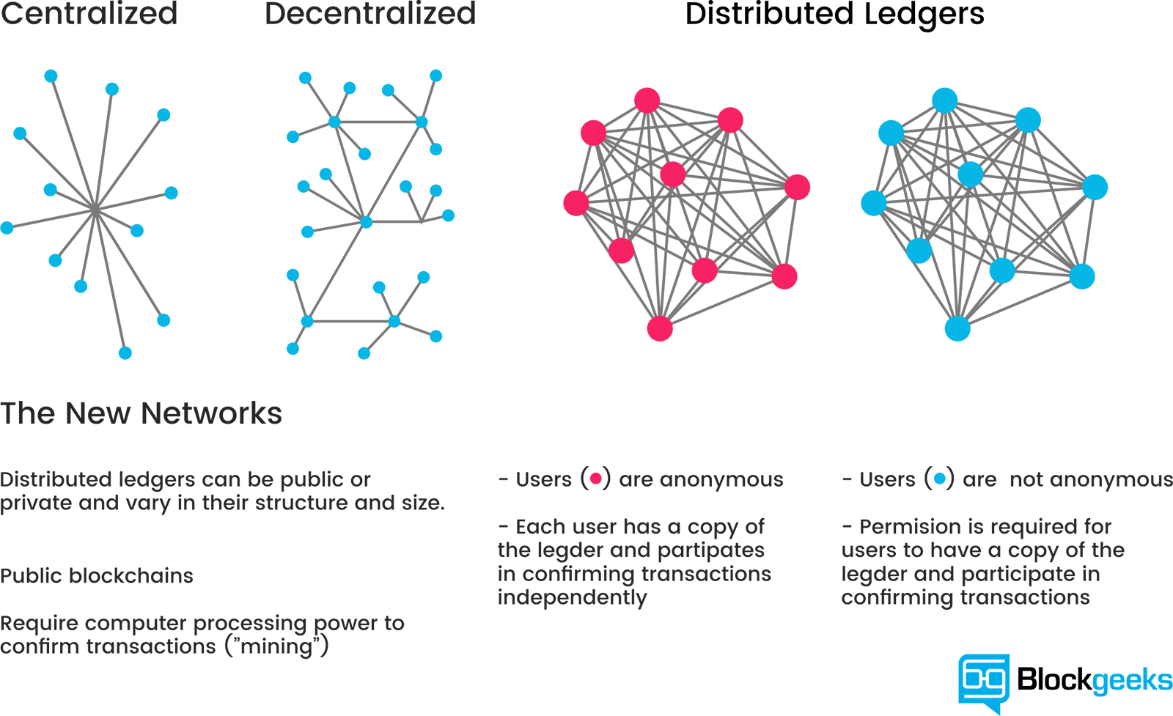
Decentralization
Replace cash with Ledger

Slide 11
The decentralized ledger (Blockchain)
Decentralization: get rid of the Third Party
Satoshi paired two main technologies
Proof of Work: to solve the double spending problem
Elliptic Curves: to solve unique access to the ledger
Nothing was newer than 2001
2001: SHA-256 finalized
1999-present: Byzantine fault tolerance
1999-present: P2P networks
1998: Wei Dai, B-money
1998: Nick Szabo, Bit Gold
1997: HashCash
1992-1993: Proof-of-work for spam
1991: cryptographic timestamp
1980: public key crypto algorithm

Slide 12

What is Blockchain Technology
Bitcoin stores all its transactions onto a public database called as Blockchain

Slide 13
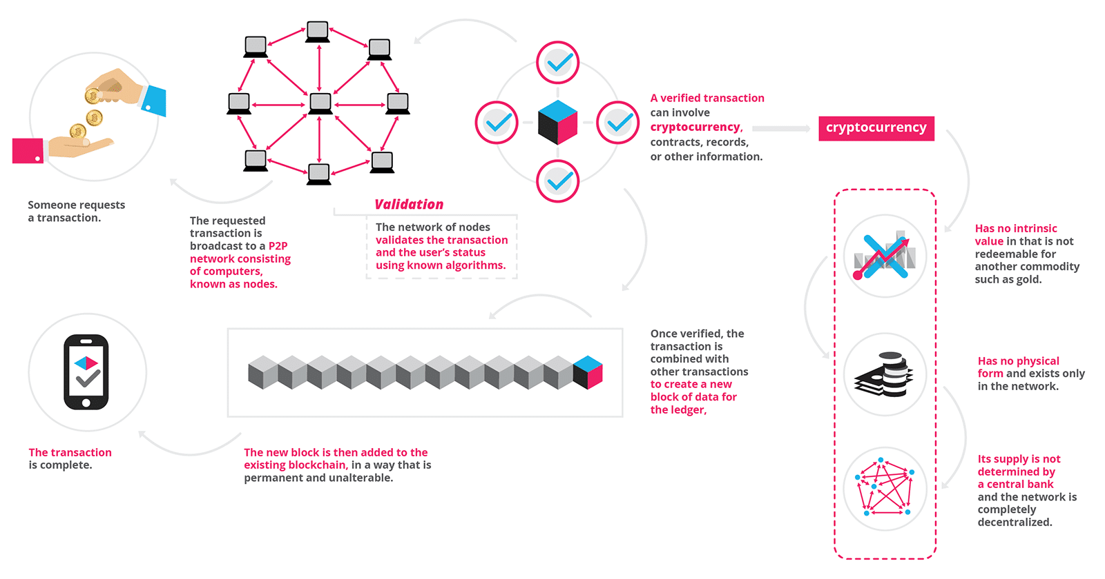
Highlights

Slide 14
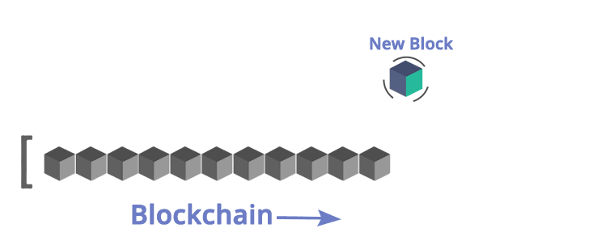
Blockchain Structure
Source: https://www.edureka.co/blog/blockchain-tutorial/

Slide 15
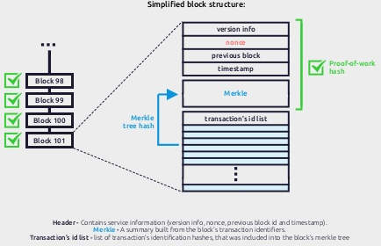
What does a block look like?

Slide 16
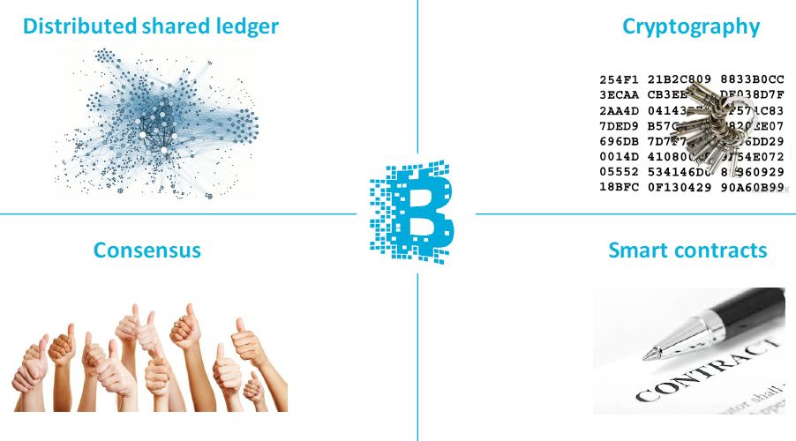
4 Key Concepts of Blockchain
Source: IBM, A new disruption in financial services

Slide 17
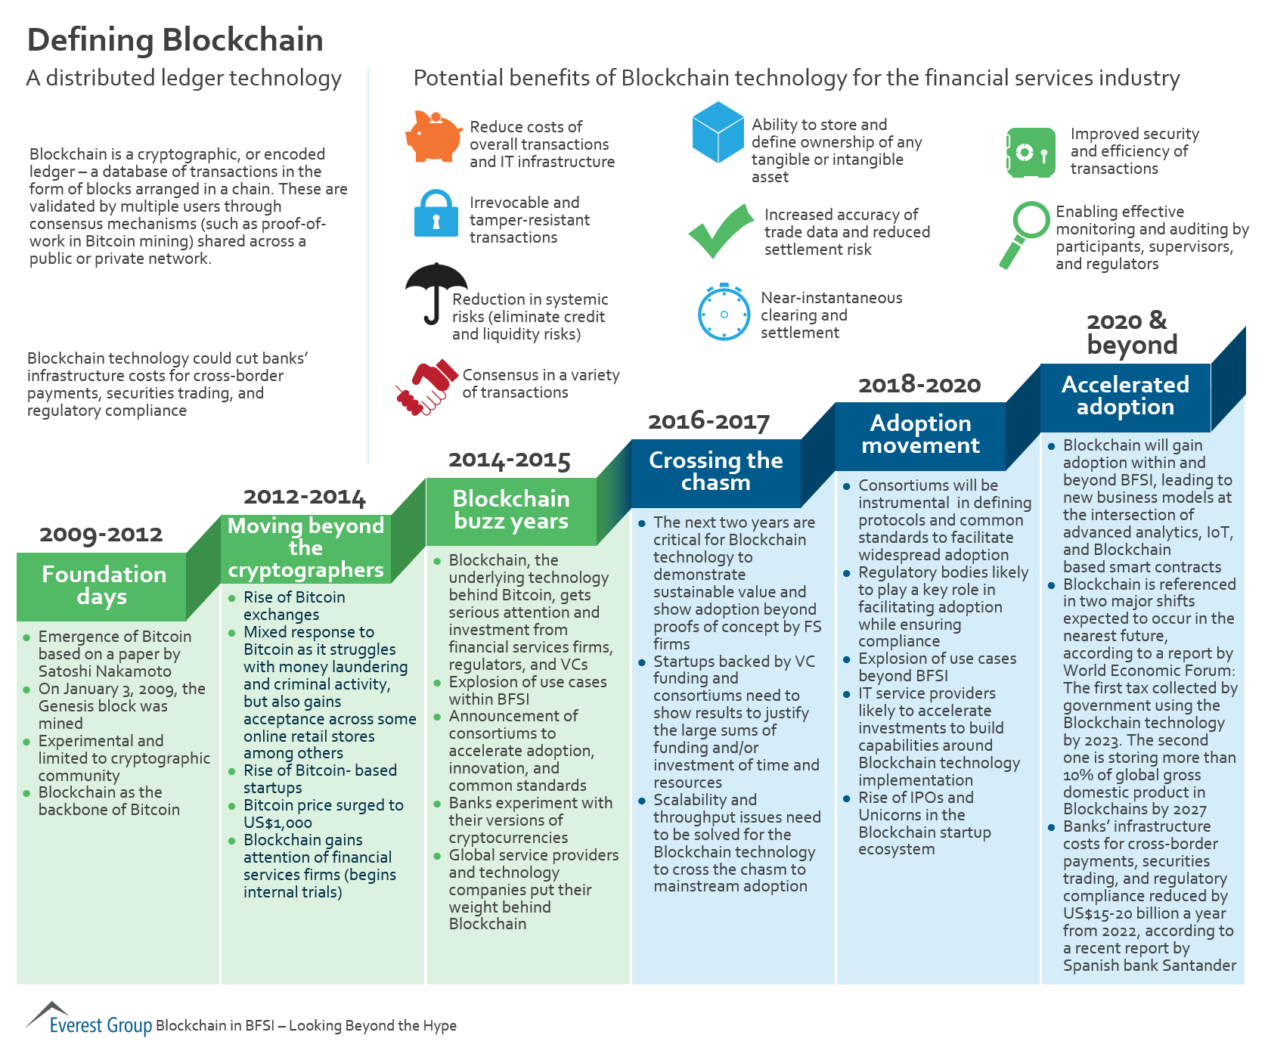
Blockchain: Distributed Ledger Technology

Slide 18



Blockchain Architecture
Revolutionary Technology
Protocol
TCP/IP, HTTP, Cloud Computation, Big Data, IoT, FinTech…
Melanie Swan: Blockchain: Blueprint for A New Economy, Jan 2015
Blockchain 1.0
Bitcoin
Programmable Money
Blockchain 2.0
Ethereum
Smart Contract
Blockchain 3.0…
Non-Financial Uses
Applications

Slide 19
Bitcoin System vs. Current Banking System
Decentralized System
The Blockchain system follows a decentralized approach when compared to banks and financial organizations which are controlled and governed by Central or Federal Authorities.
Here, everyone who is involved with the system holds some power.
Public Ledgers
The ledger which holds the details of all transactions which happen on the Blockchain, is open and completely accessible to everyone who is associated with the system.
Even though the complete ledger is publicly accessible, the details of the people involved in the transactions remains completely anonymous.
Verification of Every Individual Transaction
Every single transaction is verified by cross-checking the ledger and the validation signal of the transaction is sent after a few minutes.
Through the usage of several complex encryption and hashing algorithm, the issue of double spending is eliminated.
Low or No Transaction Fees
These transaction fees are however relatively quite less when compared to the fees implied by banks and other financial organizations.
If a transaction needs to be completed on priority then an additional transaction fees can be added by the user so as to have the transaction verified on priority.

Slide 20
the key business benefits
Time savings:
Cost savings:
Tighter security:
Enhanced privacy:
Improved auditability:
Increased operational efficiency:

Slide 21
Building trust with blockchain
Distributed and sustainable:
Secure, private, and indelible:
Transparent and auditable:
Consensus-based and transactional:
Orchestrated and flexible:

Slide 22
Why It’s Called “Blockchain”

Slide 23
Different Players in Implementation
Blockchain user
Regulator
Blockchain developer
Blockchain network operator
Traditional processing platforms
Traditional data sources
Certificate authority

Slide 24
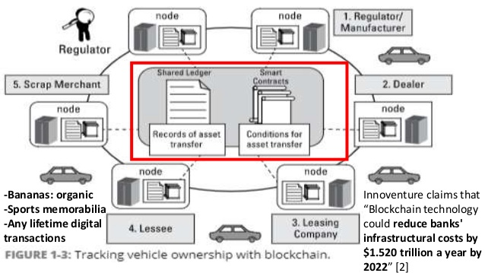
Block Chain usecase (dubai)

Slide 25
HyperLedger Introduction

Slide 26
Hyperledger Fabric
The Linux Foundation founded Hyperledger in 2015
Hyperledger Fabric is a platform for distributed ledger solutions in industrial level.
A modular architecture - Delivers high degrees of confidentiality, resiliency, flexibility and scalability.
It is designed to support pluggable implementations of different components, and accommodate the complexity and intricacies that exist across the economic ecosystem.
Breaks from some other blockchain systems is that it is private and permissioned

Slide 27
Hyperledger Fabric - Cont.
Like other blockchain technologies, it has a ledger, uses smart contracts, and is a system by which participants manage their transactions.
Ledger data can be stored in multiple formats, consensus mechanisms can be switched in and out.
Offers the ability to create channels, allowing a group of participants to create a separate ledger of transactions.
Hyperledger is based on blockchain but its not a crypto currency.
There is no mining, just order system do it.
Operational power: 0.5 million operations per minute where as other blockchain does only 1000.

Slide 28
In Summary
Hyperledger Fabric is enterprise grade distributed ledger based on blockchain technologies that uses smart contracts to enforce trust between parties.
Hyperledger in general do not enforce any requirements about the hardware, network infrastructures, additional software around it, security models etc.
No concept of computational power.

Slide 29
Advantages of Hyperledger Fabric
Permissioned membership
Performance, scalability, and levels of trust
Data on a need-to-know basis
Rich queries over an immutable distributed ledger
Modular architecture supporting plug-in components
Protection of digital keys and sensitive data

Slide 30
Hyperledger Components
Fabric CA,
Peer
Ordering service
Channel
Chaincode

Slide 31
Fabric CA
The Hyperledger Fabric CA is a Certificate Authority (CA) for Hyperledger Fabric.
It provides features such as:
registration of identities, or connects to LDAP as the user registry
issuance of Enrollment Certificates (ECerts)
certificate renewal and revocation
consists of both a server and a client component.

Slide 32
CA – WorkFlow

Slide 33
CA cont.
Every single operation that is executed inside hyperledger fabric must be cryptographically signed with this certificate.
You can add attributes, roles
Certificates are X.509 standards.
You can remove the necessity of certificates if you don’t need it.
Chaincodes read this data and make business decisions.

Slide 34
Peer
Peer is the place where the ledger and the blockchain data is stored.
You must have more than one peer in production.
One peer may be part of many channels.
Every single channel is inside the peer.
It endorse any update of the ledger.
You can create backup of the ledger from the peer

Slide 35
Ordering Service
Ordering service is actually the heart of consensus algorithm and the heart of hyper ledger fabric.
Main role is to provide the order of operations.
before committing anything to ledger it must pass through the ordering service.
it is responsible for verification, security, policy verification etc.

Slide 36
Channel
Channel is a private “subnet” of communication between two or more specific network members.
A channel is defined by members (organizations), anchor peers per member, the shared ledger, chaincode application(s) and the ordering service node(s).
Each peer that joins a channel, has its own identity given by a membership services provider (MSP).

Slide 37
Channel cont.
channels are completely isolated,
they have different ledgers, different height of blocks, policies, stories, rules.
completely isolated instance of hyper ledger fabric.
never exchange data.
outside of a channel , one can’t even see that there is a channel.
you can make a policy who can see the data in the channel and who can make an operation.
every single party inside a channel must agree about other parties.

Slide 38
Channel configuration properties
Versioned: All elements of the configuration have an associated version which is advanced with every modification. Further, every committed configuration receives a sequence number.
Permissioned: Each element of the configuration has an associated policy which governs whether or not modification to that element is permitted. Anyone with a copy of the previous configtx (and no additional info) may verify the validity of a new config based on these policies.
Hierarchical: A root configuration group contains sub-groups, and each group of the hierarchy has associated values and policies. These policies can take advantage of the hierarchy to derive policies at one level from policies of lower levels.

Slide 39
Chaincode
A chaincode typically handles business logic agreed to by members of the network, so it similar to a “smart contract”.
All your business logic is inside the chaincode.
Its written in Go. Implementation of java and javascript are on the way.
Chaincode me installed in every peer and channel.
Policy must be provided.

Slide 40
Hyperledger Composer
Hyperledger Composer is a set of collaboration tools for building blockchain business networks that make it simple and fast for business owners and developers to create smart contracts and blockchain applications to solve business problems
Extensive
Open development toolset and
Framework to make developing Blockchain applications easier.

Slide 41
Environment setup

Slide 42
Installing the pre-requisites
Operating Systems: Ubuntu Linux 14.04 / 16.04 LTS (both 64-bit), or Mac OS 10.12
Docker Engine: Version 17.03 or higher
Docker-Compose: Version 1.8 or higher
Node: 6.x (note versions 7 and higher are not supported)
npm: v3.x or v5.x
git: 2.9.x or higher
Python: 2.7.x
nvm and Apple Xcode (for Mac)
Hyperledger Composer Extension for VSCode.

Slide 43
Implementation
http://hyperledger-fabric.readthedocs.io/en/release-1.0/build_network.html

